Slide 1


Slide 2
The Australasian Allied Health Benchmarking Consortium (AAHBC) was convened in 1997 as the National Allied Health Benchmarking Consortium (NAHBC) to develop a standardised method of recording allied health practitioners’ activity in Australia’s public hospitals.

Slide 3
Its current aim is to enable a network of collaborative teaching hospitals to develop and maintain a standardised approach to benchmarking and subsequently improved practices.

Slide 4
AAHBC provides input into allied health and whole of health strategies and projects through the utilisation of quality data sets and the combined input of experienced members across the network of participating hospitals.

Slide 5
Membership criteria
WILLINGNESS TO PARTICIPATE IN GROUP DISCUSSION AND PROJECTS
  Established allied health governance structure
  Tertiary or teaching hospital with approximately 500 beds with significant annual separations
  Allied health data collected using the Australian Allied Health Classification System
  Allied health data collection system/s in place
  Allied Health membership of The Health Roundtable is beneficial and encouraged.
    Further information www.aahbc.org
    Contact Cherie Hearn, Chair AAHBC cherie.hearn@health.qld.gov.au

Slide 6
Clinical Care Ratios for Allied Health
Australasian Allied Health Benchmarking Consortium

Slide 7
Definition of Clinical Care Ratio
CCRs
Time spent on direct clinical activities
  (IPA + NIPA)
Compared with non-direct clinical care activities (CSM + TT + R)
Expresses as a % of total time work
Will use the direct clinical % in this presentation

Slide 8
Project Aim
Determine how much non-direct clinical time is appropriate for allied health professionals
Study sought to:
  Quantify and recommend CCRs according to seniority and role type
  Assess whether CCRs are associated with seniority level or profession

Slide 9
Definitions
Tier 1- Entry level practitioner, who is generally employed to rotate between work areas. Tier 2 Practitioner who is employed as a more experienced clinician, who is less likely to rotate between work areas, and is developing more specialised skills.
Tier 3 -Staff with clinical expertise who in smaller facilities will be site managers Tier 4 -These staff will be programme leaders in large sites or heads of discipline with clinical loads at smaller sites. Tier 5 - Staff will have responsibilities extending across a number of sites or in larger facilities and will have minimal to no clinical case load.

Slide 10
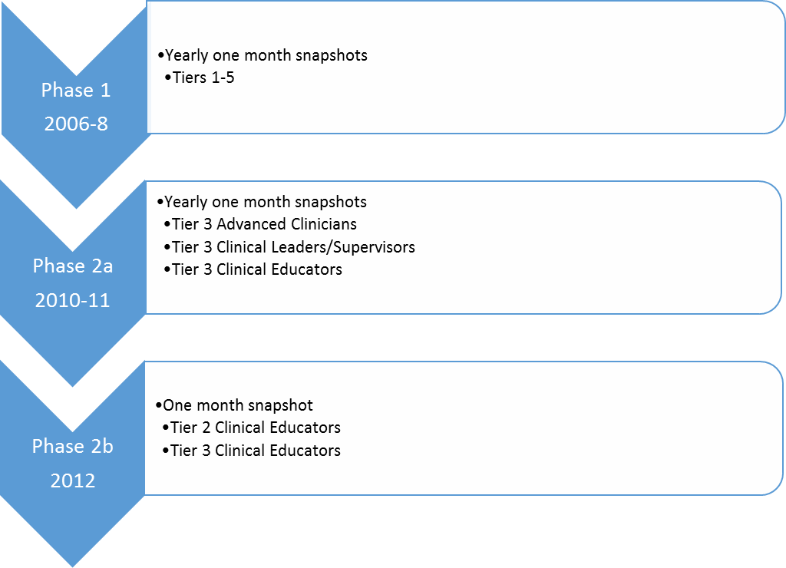
Data Collection

Slide 11
Tier 3 – Advanced Clinician
Experienced clinician with high level of clinical expertise and advanced skills.
They would be leading service development and quality improvement initiatives and be involved in research in there area of clinical expertise.
There would be no team leader or management responsibility in this category

Slide 12
Tier 3- Clinical Leader/Supervisor
Staff with clinical expertise and a clinical caseload who also supervises a team of clinicians +/- manages a clinical work area.
They would be leading service development and quality improvement activities in their clinical work area.

Slide 13
Tier 3 – Clinical Educator
A clinical educator who in addition to delivering clinical education has a role either in the coordination of placements, university teaching or other strategic activity related to clinical education.
A Tier 2 Clinical Educator is delivering the clinical education

Slide 14
No. of Responses 2006-8
Tier | Physiotherapy (PT) | Occupational Therapy (OT) | Speech Pathology (SP) | Nutrition & Dietetics (N&D) | Social Work (SW) | Total
1 | 343 | 162 | 87 | 111 | 152 | 855
2 | 287 | 149 | 59 | 115 | 131 | 741
3 | 131 | 82 | 38 | 45 | 68 | 364
4&5 | 15 | 25 | 14 | 16 | 6 | 76
Total | 776 | 418 | 198 | 287 | 357 | 2036

Slide 15
Phase 2 2011 Responses- Tier 3
Tier 3 Category | PT | OT | SP | N & D | SW | Total
Senior/Clinical Leader | 56 | 54 | 14 | 18 | 32 | 174
Advanced Clinician | 39 | 42 | 10 | 9 | 11 | 111
Clinical Educator | 4 | 1 | 3 | 3 | 2 | 13
Total | 99 | 97 | 27 | 30 | 45 | 298

Slide 16
Responses 2012- Clinical Educators
Category | PT | OT | SP | N & D | SW | Total
Tier 2 Clinical Educator | 60 | 50 | 22 | 35 | 24 | 191
Tier 3 Clinical Educator | 2 | 4 | 4 | 2 | 4 | 16
Total | 62 | 54 | 26 | 37 | 28 | 207

Slide 17
Mean CCR (95% Confidence Interval)
Tier | OT | SP | PT | ND | SW | All
1 | 80.05 (77.78-82.32) | 76.39 (73.56-79.21) | 83.54 (81.69, 85.39) | 73.57 (69.39, 77.75) | 75.63 (73.19, 78.07) | 77.93 (76.51, 79.35)
2 | 74.46 (71.66-77.26) | 72.79 (68.19, 77.38) | 73.98 (70.32, 77.74) | 68.45 (63.70, 73.21) | 73.17 (69.54, 76.81) | 72.52 (70.74, 74.31)
3 Advanced Clinician | 64.83 (50.35, 79.32) | 71.17 (61.73, 80.60) | 76.29 (69.49, 83.08) | 60.33 (40.82, 79.85) | 69.25 (55.00, 83.50) | 69.54 (64.22, 74.86)
All of above | 75.46 (72.60, 78.31) | 74.22 (71.61, 76.82) | 78.58 (76.20, 80.96) | 70.06 (66.69, 73.43) | 73.89 (71.50, 76.27) | 74.54 (73.27, 75.80)

Slide 18
Mean CCR (95% Confidence Interval)
Tier | OT | SP | PT | ND | SW | All
3 Advanced Clinician | 64.83 (50.35, 79.32) | 71.17 (61.73, 80.60) | 76.29 (69.49, 83.08) | 60.33 (40.82, 79.85) | 69.25 (55.00, 83.50) | 69.54 (64.22, 74.86)
3 Clinical Team Leader | 58.33 (52.28, 64.38) | 58.90 (49.42, 68.38) | 58.30 (52.23, 64.37) | 50.67 (33.13, 68.20) | 62.78 (53.59, 71.96) | 58.33
3 Clinical Educator | 65.40 (51.50, 79.30) | 33.29 (16.23, 50.34) | 59.83 (38.08, 81.58) | 55.00 (42.73, 67.27) | 35.80 (16.66, 54.94) | 48.83
2 Clinical Educator | 64.33 (56.66, 72.00) | 64.00 (55.52, 72.48) | 53.50 (37.25, 69.75) | 49.00 (28.57, 69.43) | 73.00 (N/A) | 58.65

Slide 19
2 Way ANOVA- Seniority
2 way ANOVA was done on Tiers with a predominant clinical load (Tier 1, Tier 2 and Tier 3 Advanced Clinician)
Significant Difference between Tiers
  More senior staff-lowest CCR
  Tier 3 > Tier 2 > Tier 1

Slide 20
2 Way ANOVA - Professions
Significantly higher CCRs for Physiotherapy compared with the other professions
Significantly lower CCRs for Nutrition & Dietetics compared with the other professions
No significant difference in CCRs between Speech Pathology, Social Work and Occupational Therapy

Slide 21
Considerations
Variation within Tiers is expected
  Range of experience
  Variation in clinical area
  Variation in role
Is CCR size and context of service dependent?-
Based on current practice and should not be considered a “gold standard”
Do higher CCRs indicate better performance and better patient outcome???
Why is there difference between professions?

Slide 22
Conclusion
CCRs are a useful tool in workload management and determining staffing levels
Can be quantified and benchmarked between like roles
CCR decreases with seniority
Differences exist between professions

Slide 23
AHHBC Staffing Models
Jim Sayer

Slide 24
Background
Benchmarking:
  Service Performance / Activity
    Episodes
    Occasions of Service
    Hours of Activity
      Per Episode Level
  Service Growth / Business Case Development
    The classic Ring-around
      How many beds do you have ?
      How much eft do you have ?

Slide 25
Past Models
2009-10? Excel Spreadsheet
2011-12? Excel Spreadsheet Ver 2.0

Slide 33
New Model
Access Database
  Used 2011-2012 data
  Uses SRG goups
  Uses Eft per bed as the comparator!
  Allows quick identification of areas for benchmarking
  Allows meaningful comparison at each level, Dept vs SRG vs DRG

Slide 34
The Trick
Translation of Clinical Hours to EFT.
Assumptions
  Stats Entry is Perfect !
  Data Matching is Perfect
  Allied Health Factor
  100 % Beds Occupancy
  Reflects previous activity not necessarily ideal activity
Flaws
  Its Assumptions !!

Slide 35
Assumptions - 1
Translation of Clinical Hrs to EFT
Allied Health Factor
  Direct Clinical Care Ratio – (75.0%)
  Leave
    Annual Leave
    ADO
    Sick Leave
    Professional Development Leave
  -> 1 Clinical Hr = 1.7458 Actual / EFT Hrs
  -> 4.58 Clinical Hrs = 8.0 Actual / EFT hrs
2088 Hrs per EFT Year

Slide 36
Assumptions - 2
Translation of Separation Activity to Beds
Normally have
  Number of Seps
  Avg LOS
  Bed days: Seps x Avg LOS
  Assume 100% Occupancy
  ->Beds: Bed Days / 365

Slide 37
AAHBC Model 2011-2012
AAHBC Model 2011 -2012
SRG -> DRG

Slide 38
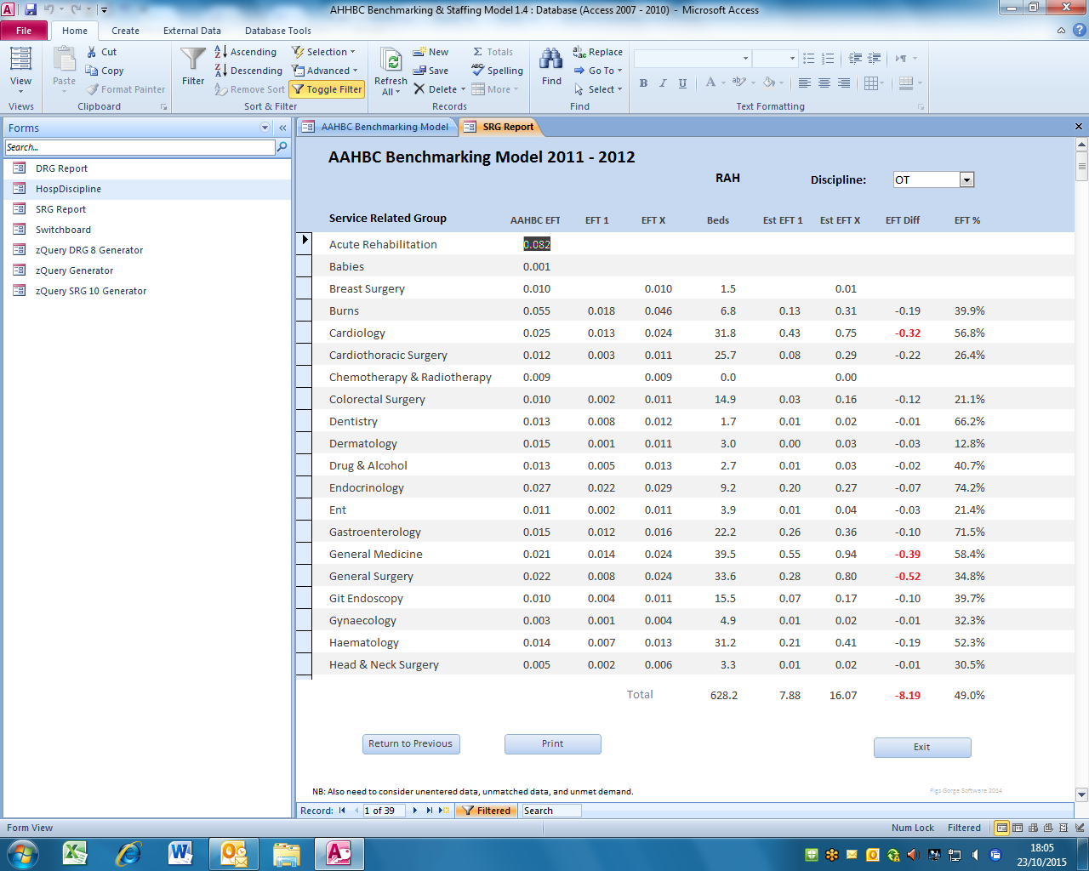

Slide 39
AAHBC Model 2014-2015
AAHBC Model 2014 -2015
Clinical Group -> Local Unit
Data will be wrapped up:
Allied Health -> Discipline -> Clinical Group

Slide 40
ClinUnit | AH | CPSY | NPSY | NUT | OT | O&P | POD | PT | SP | SW | ClinUnit2
BURN | 0.356 | 0.006 | 0.000 | 0.041 | 0.120 | 0.015 | 0.000 | 0.084 | 0.033 | 0.056 | BURN
EMER | 0.321 | 0.000 |  | 0.002 | 0.075 | 0.002 | 0.000 | 0.110 | 0.001 | 0.131 | EMER
ENDO | 0.174 | 0.001 | 0.001 | 0.045 | 0.018 | 0.010 | 0.014 | 0.047 | 0.005 | 0.033 | ENDO
ENT1 | 0.182 |  | 0.000 | 0.040 | 0.010 | 0.002 | 0.000 | 0.054 | 0.058 | 0.017 | ENT1
ENT2 | 0.086 |  |  | 0.004 | 0.017 | 0.000 | 0.001 | 0.035 | 0.001 | 0.027 | ENT2
GAST | 0.136 |  | 0.001 | 0.048 | 0.015 | 0.000 | 0.001 | 0.030 | 0.006 | 0.036 | GAST
GenMed | 0.311 |  | 0.001 | 0.063 | 0.061 | 0.003 | 0.003 | 0.096 | 0.018 | 0.066 | GMA
NEUR | 0.232 |  | 0.004 | 0.022 | 0.041 | 0.003 | 0.001 | 0.086 | 0.029 | 0.046 | NEUR
NSUR | 0.340 |  | 0.002 | 0.039 | 0.075 | 0.010 | 0.000 | 0.124 | 0.033 | 0.056 | NSUR
ORTH | 0.278 |  |  | 0.029 | 0.064 | 0.018 | 0.001 | 0.136 | 0.007 | 0.023 | ORTH
STRO | 0.455 |  | 0.001 | 0.053 | 0.116 | 0.002 | 0.001 | 0.127 | 0.103 | 0.052 | STRO
VASC | 0.138 |  | 0.000 | 0.019 | 0.032 | 0.007 | 0.010 | 0.050 | 0.004 | 0.016 | VASC

